Slide 1



ARCHIMEDES PHARMA
Designing
Vaccines
From development to distribution
ARCHIMEDES PHARMA | VACCINES

Slide 2

01
Introduction to vaccines
Content
Outline
02
Types and forms
03
Challenges and opportunities
Topics for discussion
04
Vaccine development
05
About Archimedes Pharma
ARCHIMEDES PHARMA | VACCINES

Slide 3

ARCHIMEDES PHARMA | VACCINES
What are vaccines?
These are immunity inducers.
Presentations are communication tools that can be used as demonstrations, lectures, speeches, reports and more. It is mostly presented before an audience.
It serves a variety of purposes, making presentations powerful tools for convincing and teaching. To create a stunning presentation, it's best to simplify your thoughts. Start with an outline of topics and identify highlights, which can be applied to whatever subject you plan on discussing.

Slide 4

Vaccines are extremely cost-effective, giving kids a healthy start in life and supporting the economic and educational foundations of entire communities. They directly lead to a healthy workforce, which is so critical to long-term development and prosperity in all countries.
— Ishan Oswal
ARCHIMEDES PHARMA | VACCINES

Slide 5

IMPACT OF IMMUNISATION
20 to 30 lakh
Deaths prevented per annum
Presentations are communication tools that can be used as demonstrations, lectures, speeches, reports and more. It is mostly presented before an audience. It serves a variety of purposes, making presentations powerful tools for convincing and teaching.
ARCHIMEDES PHARMA | VACCINES

Slide 6
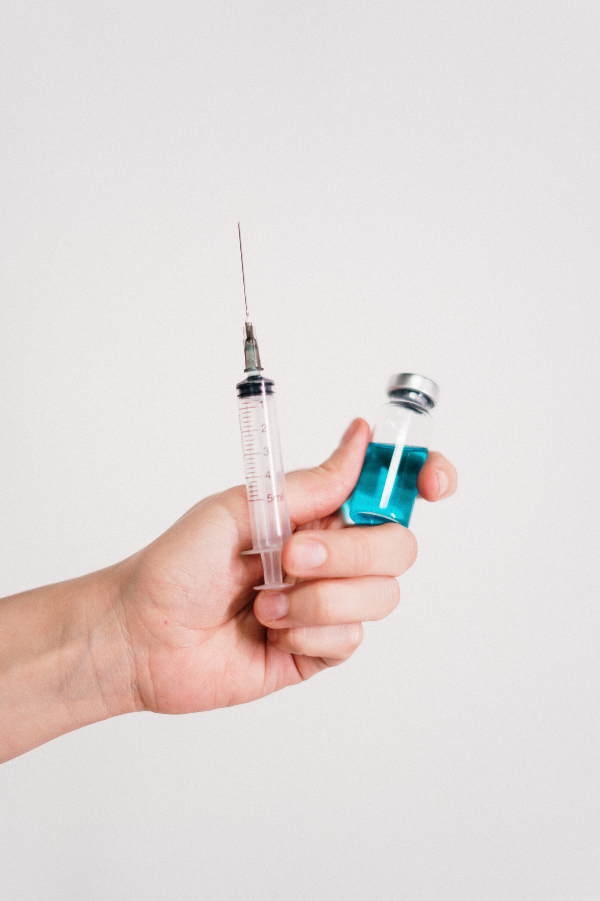

In order to create a
stunning presentation
It's best to simplify your thoughts. Start with an outline of topics and identify highlights, which can be applied to whatever subject you plan on discussing.
You can then organise them into your introduction, your main content and your conclusion. Make sure you do enough research to support your points.
ARCHIMEDES PHARMA | VACCINES

Slide 7

Risks and
Benefits
Oral Vaccines
Presentations are communication tools that can be used as demonstrations, lectures, speeches, reports and more. It is mostly presented before an audience.
Intranasal Vaccines
Presentations are communication tools that can be used as demonstrations, lectures, speeches, reports and more. It is mostly presented before an audience.
Subcutaneous Vaccines
Presentations are communication tools that can be used as demonstrations, lectures, speeches, reports and more. It is mostly presented before an audience.
ARCHIMEDES PHARMA | VACCINES

Slide 8





Key Opportunities
A favorable landscape
Urgency
Necessity
Timing
Support
Impact
ARCHIMEDES PHARMA | VACCINES

Slide 9


Traditional
Vaccine
Development
Accelerated Vaccine Development
To create a stunning presentation
To create a stunning presentation
It's best to simplify your thoughts. Start with an outline of topics and identify highlights, which can be applied to whatever subject you plan on discussing.
You can then organise them into your introduction, your main content and your conclusion. Make sure you do enough research to support your points.
It's best to simplify your thoughts. Start with an outline of topics and identify highlights, which can be applied to whatever subject you plan on discussing.
You can then organise them into your introduction, your main content and your conclusion. Make sure you do enough research to support your points.

Slide 10
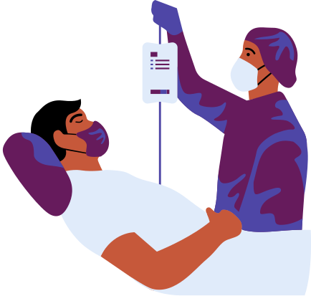

The Race for New Vaccines
Presentations are communication tools that can be used as demonstrations, lectures, speeches, reports and more. It is mostly presented before an audience. It serves a variety of purposes, making presentations powerful tools for convincing and teaching.
It is mostly presented before an audience. It serves a variety of purposes, making presentations powerful tools for
convincing and teaching.
To create a stunning presentation, it's best to simplify your thoughts. Start with an outline of topics and identify highlights, which can be applied to whatever subject you plan on discussing.
ARCHIMEDES PHARMA | VACCINES

Slide 11

Clinical Development
Phase 1:
Limited Trial
Phase 2:
Expanded trial
Phase 3:
Large-scale trial
Presentations are communication tools that can be used as demonstrations, lectures, speeches, reports and more. It is mostly presented before an audience.
Presentations are communication tools that can be used as demonstrations, lectures, speeches, reports and more. It is mostly presented before an audience.
Presentations are communication tools that can be used as demonstrations, lectures, speeches, reports and more. It is mostly presented before an audience.
Presentations are communication tools that can be used as demonstrations, lectures, speeches, reports and more. It is mostly presented before an audience.
ARCHIMEDES PHARMA | VACCINES

Slide 12


Criteria
for success
Safety
Efficacy
Scalability
Affordability
Presentations are communication tools that can be used as demonstrations, lectures, speeches, reports and more.
Presentations are communication tools that can be used as demonstrations, lectures, speeches, reports and more.
Presentations are communication tools that can be used as demonstrations, lectures, speeches, reports and more.
Presentations are communication tools that can be used as demonstrations, lectures, speeches, reports and more.
ARCHIMEDES PHARMA | VACCINES

Slide 13


Vaccine Development
Cycle
Pre-clinical Stage
Presentations are communication tools that can be used as demonstrations, lectures, speeches, reports and more.
Quality Control
Clinical Development
A multi-step process
Presentations are communication tools that can be used as demonstrations, lectures, speeches, reports and more.
Presentations are communication tools that can be used as demonstrations, lectures, speeches, reports and more.
Mass Manufacturing
Regulatory Approval
Presentations are communication tools that can be used as demonstrations, lectures, speeches, reports and more.
Presentations are communication tools that can be used as demonstrations, lectures, speeches, reports and more.

Slide 14




Our Leaders
Medical visionaries
Iravati Chauhan, MD
Yatish Ugare, M.Pharm
Satish Wagh, M.Pharm
Founder and CEO
Lead Researcher
Lead pharmacist
ARCHIMEDES PHARMA | VACCINES

Slide 15

Phone Number
123-456-7890
Questions or comments?
Email Address
hello@reallygreatsite.com
Get in touch!
Website
www.reallygreatsite.com
ARCHIMEDES PHARMA | VACCINES

